Slide 1



UNIT 4 Jobs and my duties
Look back 4

Slide 2
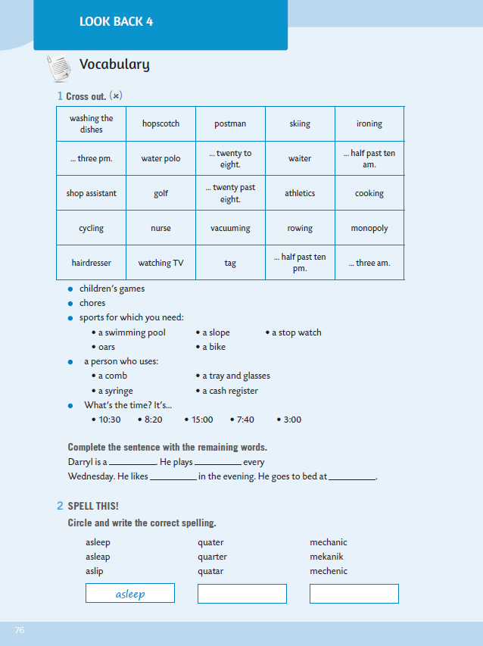
Kako smo došli do kraja četvrte nastavne teme našeg udžbenika Dip in 5, vrijeme je da ponovimo riječi i strukture koje smo naučili.
Prisjetimo se da smo naučili izreći koliko ima sati na engleskom jeziku, zanimanja, kućanske poslove, nazive sportova… Ali smo isto tako naučili i kada upotrebljavamo član A, a kada član AN, te smo naučili izricati radnje koje se ponavljaju koristeći Present Simple.
WB, page 76.

Slide 3
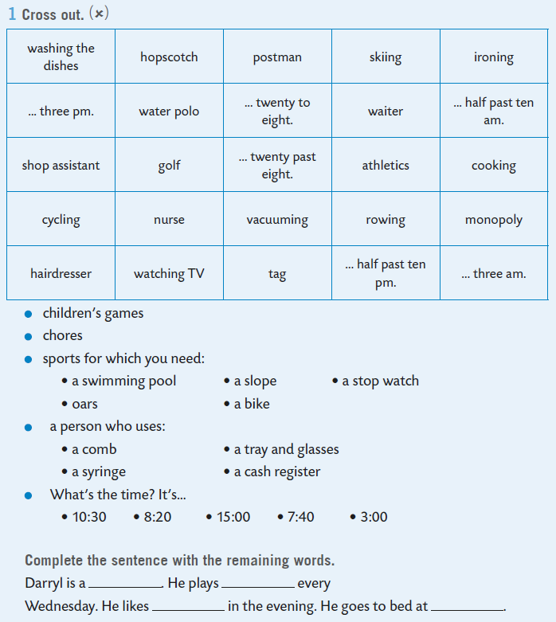
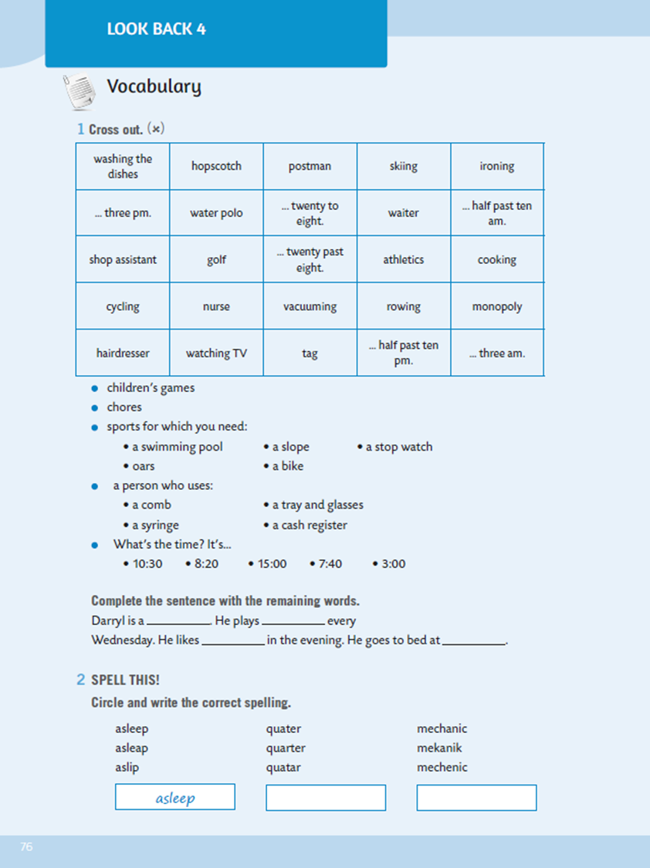
In task 1, you need to cross out the words bellow the table, and then complete the sentence with the remaining words. Finish the text about Darryl.

Slide 4
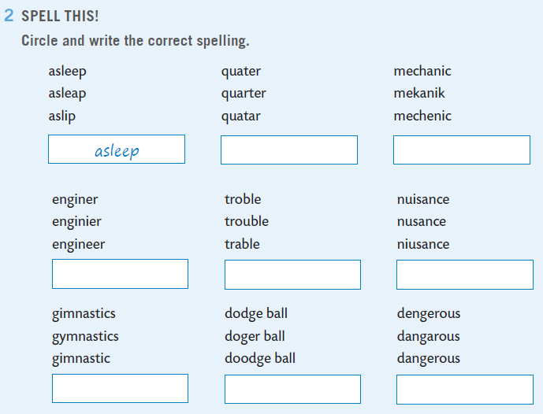

Next task deals with spelling. Circle and write the correct spelling.
quarter

Slide 5
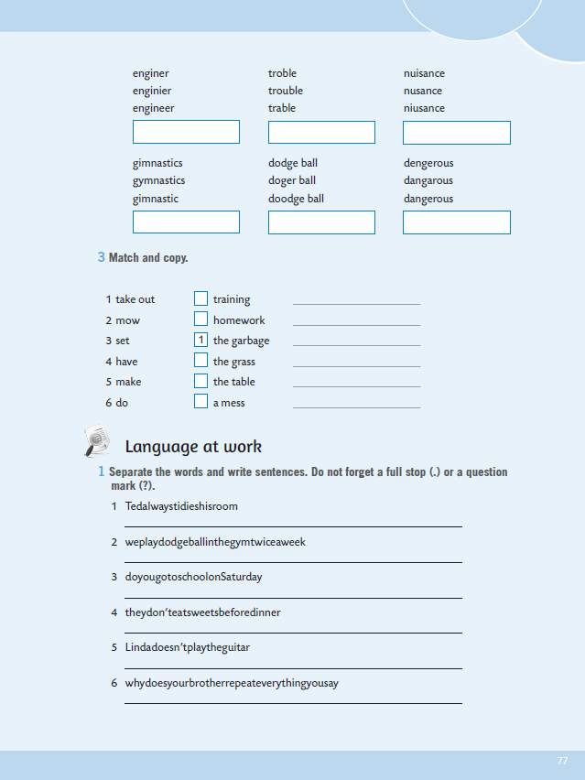
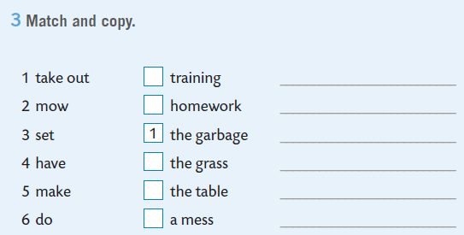
Match and copy the expressions in task 3.
take out the garbage
2
mow the grass

Slide 6
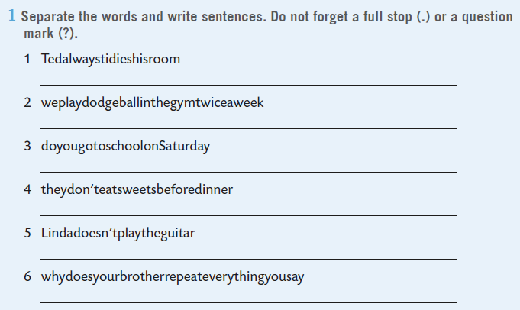
Ted always tidies his room.
We play dodge ball in the gym twice a week.
Nakon što si ponovio riječi naučene u proteklom periodu vrijeme je da ponoviš i Present Simple.
Prolistaj svoju bilježnicu i prisjeti se što si naučio o tom glagolskom vremenu, a ako ti još uvijek nešto nije jasno možeš pogledati i video na sljedećoj poveznici: https://youtu.be/ni3JB0hrxyw
Na 77. stranici radne bilježnice imaš zadatke u kojima možeš provjeriti jesi li razumio Present Simple!
WB, p. 77. Separate the words and write sentences. Do not forget a full stop (.) or a question mark (?).

Slide 7
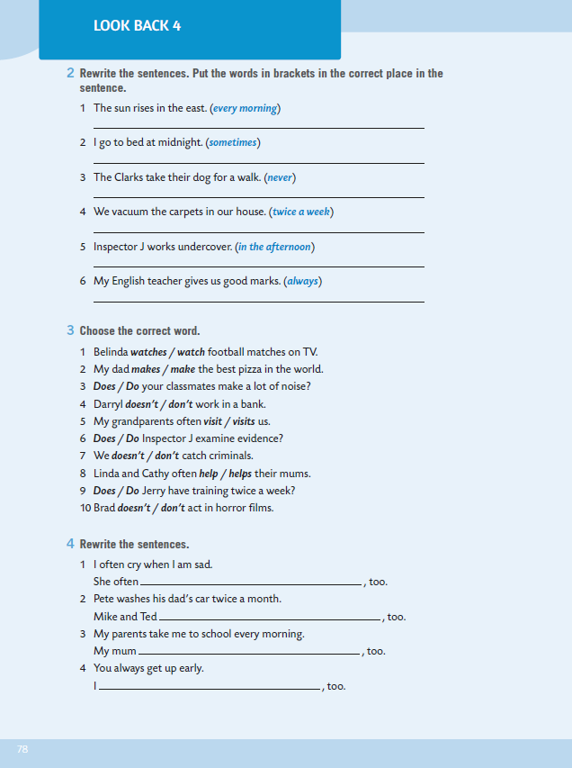
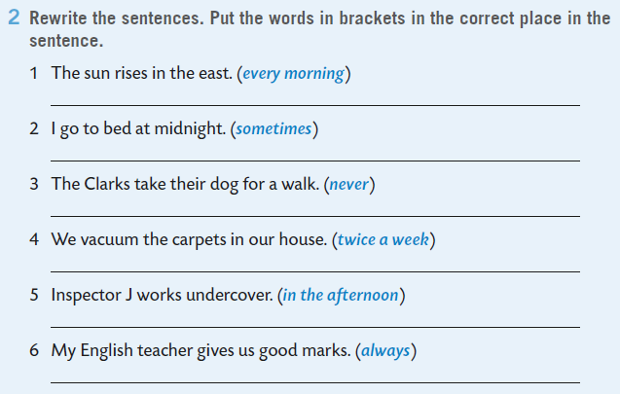
WB, p. 78. Rewrite the sentences. Put the words in brackets in the correct place in the sentence.
The sun rises in the east every morning.| Every morning the sun rises in the east.
I sometimes go to bed at midnight.

Slide 8
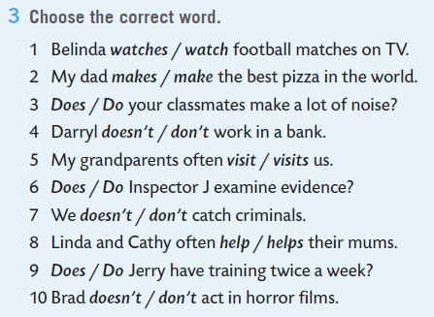
Choose the correct word.

Slide 9
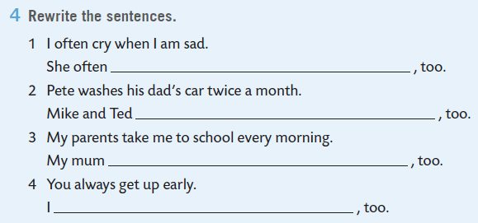
Rewrite the sentences. Pay attention to the ending!
cries
wash dad's car twice a month

Slide 10
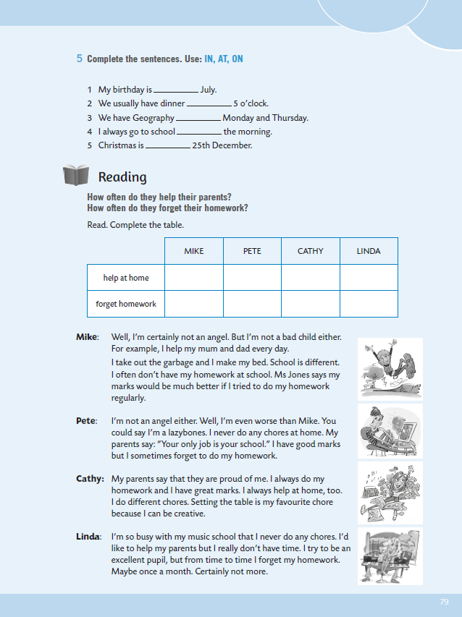
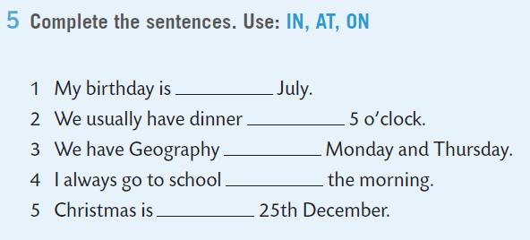
Complete the sentences. Use: IN, AT, ON. IN koristimo ispred naziva mjeseci, AT ispred sati, a ON ispred datuma i dana u tjednu!
in
at
Practice here: https://www.e-sfera.hr/dodatni-digitalni-sadrzaji/464d821a-ac7b-4e8e-b655-7fb60aa9fffe/assets/interactivity/kviz_4/index.html

Slide 11
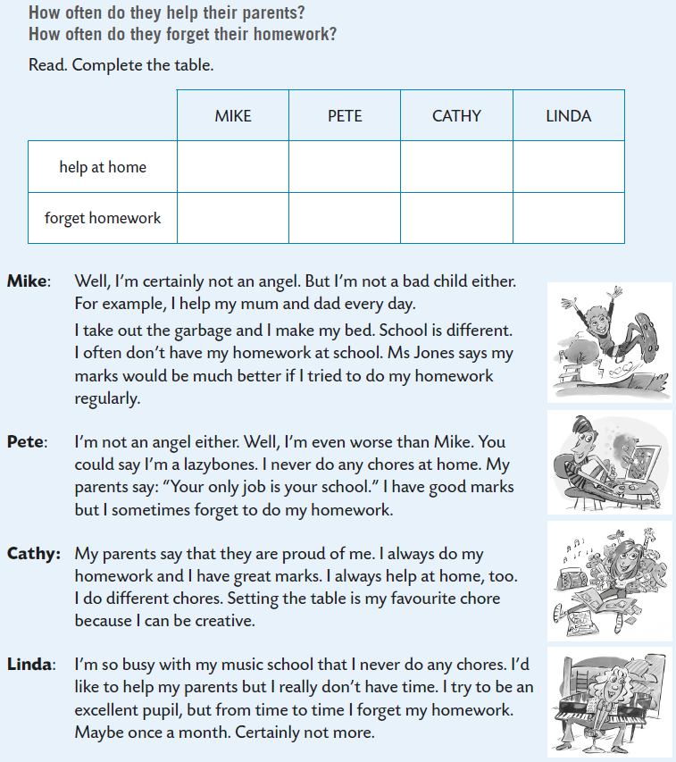
every day
never
Read and complete the table.

Slide 12
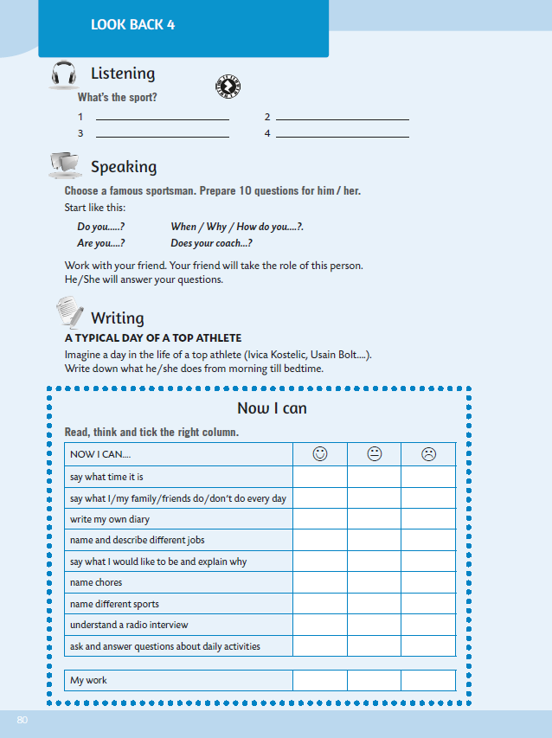

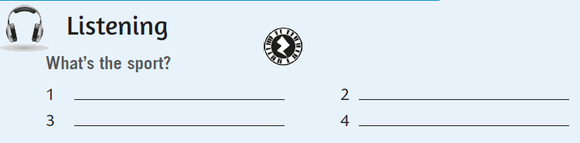
In the listening section, listen and guess the sports: https://www.e-sfera.hr/dodatni-digitalni-sadrzaji/464d821a-ac7b-4e8e-b655-7fb60aa9fffe/assets/audio/look_back_4-what_s_the_sport_.mp3
skiing
skating
athletics
rowing

Slide 13
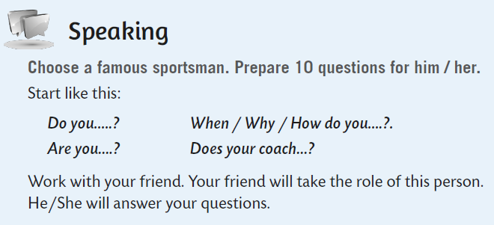
Choose a famous sportsman. Prepare 10 questions for him / her. Call one of your classmates.

Slide 14
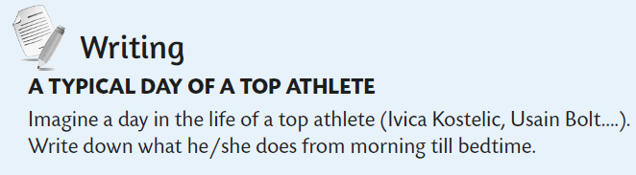
Imagine a day in the life of a top athlete (Ivica Kostelic, Usain Bolt….). Write down what he/she does from morning till bedtime.

Slide 15
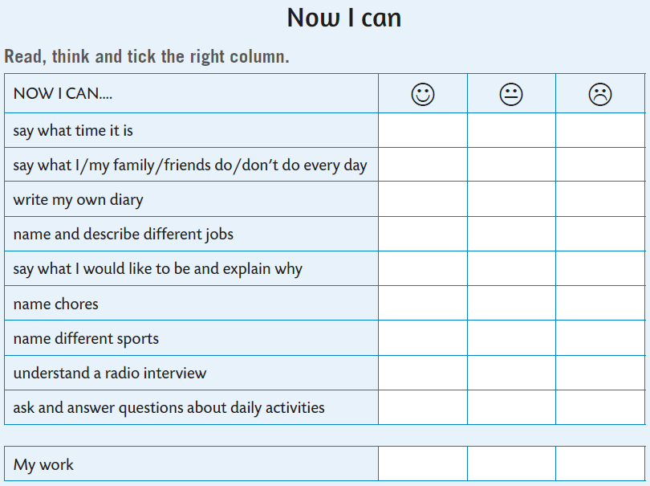



Now you can self-evaluate. Read the sentences, think and tick the right column.
- izreći koliko ima sati
- izreći što ja i moja obitelj radimo svakog dana
- napisati svoj vlastiti dnevnik
- imenovati i opisati različite poslove
- izreći što želiš biti i zašto
- imenovati kućanske poslove
- imenovati sportove
- razumjeti radijski intervju
- pitati i odgovarati na pitanja o svakodnevnim aktivnostima

